Slide 1
Advanced Web Application for Blood Patron Prediction Using SVC
SWEATHA R - 210701275
THAMIZH BHARATHI M - 210701288
Rajalakshmi Engineering College

Slide 2
01
ABSTRACT
02
INTRODUCTION
03
LITERATURE REVIEW
04
RESEARCH GAPS
CONTENTS
05
PROPOSED METHODOLOGY
06
RESULTS AND DISCUSSION
07
COMPARATIVE ANALYSIS
08
CONCLUSION AND FUTURE WORK
09
REFERENCES

Slide 3
ABSTRACT
Blood donation is crucial for saving lives, yet predicting whether individuals will donate blood again poses challenges for blood banks. Our project aims to address this by developing a predictive model that analyzes factors such as the time since the last donation, number of donations, volume of donated blood, and total months since the first donation. Using machine learning algorithms, particularly the Support Vector Classifier (SVC), we effectively predict donor return likelihood. This data-driven tool helps blood banks in increasing repeat donations and maintaining a stable blood supply, while also informing targeted campaigns to encourage regular blood donation, thereby supporting a sustainable blood transfusion ecosystem.

Slide 4
INTRODUCTION
Blood transfusion is essential in modern healthcare, but maintaining a stable blood supply is challenging due to factors like donor recruitment and retention. While one-time donors help, regular repeat donors are crucial for sustainability. Predicting donor return behavior is complex due to varied motivations, and traditional promotional campaigns may not effectively target likely repeat donors. We propose a data-driven solution using machine learning algorithms to analyze historical donation data, including time since the last donation, donation frequency, and volume of donated blood. This predictive model aims to identify donors most likely to return, enabling blood banks to enhance donor retention and sustain blood transfusion services.

Slide 5
LITERATURE REVIEW
Title | Authors | Journal | Year Published | Contributions | Limitations
A systematic review of predictive blood donor retention models | Nahashon Kiarie, Amos Chege Kirongo, Mary Mwadulo | African Journal of Science, Technology and Social Sciences | 2024 | Systematic review of machine learning techniques for predicting blood donor retention | Need for comprehensive data model interpretability, and regular updates to accommodate changing behaviors
Predicting the Intention to Donate Blood among Blood Donors Using a Decision Tree Algorithm | Cristian Salazar-Concha, Patricio Ramírez-Correa | Symmetry | 2021 | Uses decision tree algorithm to predict blood donation intention with high accuracy | Limited attributes considered; based on Chilean donor data, which may limit generalizability
Predicting donations and profiling donors in a blood collection center: a Bayesian approach | Ilenia Epifani, Ettore Lanzarone, Alessandra Guglielmi | Flexible Services and Manufacturing Journal | 2023 | Bayesian model for predicting donation events and profiling donors, applied to Italian blood donor data | Complexity of Bayesian approach; specific to Milan department's data, may not generalize broadly

Slide 6
LITERATURE REVIEW
Title | Authors | Journal | Year Published | Contributions | Limitations
Blood Donor Arrival Forecasting Using Regression Model and Analysis of Donor Behavioural Pattern | Towsif Ahamed, Md. Nazrul Islam, S. M. Taslim Uddin Raju, M. M. A. Hashem | 2022 25th International Conference on Computer and Information Technology (ICCIT) | 2022 | Logistic regression and decision-tree methods to forecast successful donations | Focus on OneBlood’s dataset; may have limitations in other contexts; primary focus on behavioral patterns
Blood Donation Prediction System Using Machine Learning Techniques | Pooja Selvaraj, Aiman Sarin, B. Ida Seraphim | 2022 International Conference on Computer Communication and Informatics (ICCCI) | 2022 | Cross-sectional study using machine learning to predict donations and identify barriers in the process | Limited to a specific medical center; focus on awareness and accessibility issues rather than prediction accuracy

Slide 7
RESEARCH GAPS
Inability to predict individual blood donation behavior at a specified time.
Lack of sustained blood supply due to the absence of retention prediction
models.
Reliance on traditional promotional campaigns, which are insufficient for
accurately predicting and ensuring regular donor return.
Inability to effectively motivate previous donors to donate again due to lack of targeted engagement strategies.
Absence of effective models to predict the likelihood of a donor donating
blood at a specified time.

Slide 8
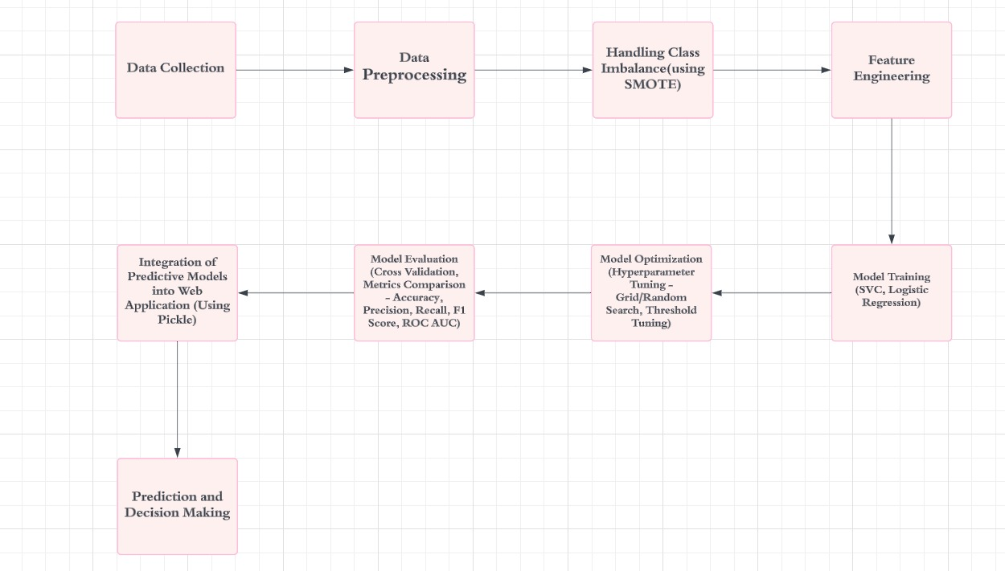
PROPOSED METHODOLOGY

Slide 9
RESULTS AND DISCUSSION
Data is collected and followed by preprocessing steps including handling missing values, normalization, and SMOTE for class balancing.
Utilized Support Vector Classifier (SVC) and Logistic Regression with features
such as time since last donation, donation frequency, blood volume donated, and
overall donation history. SVC demonstrated superior performance over Logistic
Regression in accuracy, recall, and ROC AUC.
Integration into a web application facilitates real-time predictions, aiding blood donation centers in resource allocation and targeted engagement.
Model | Accuracy | Precision | Recall | F1 Score | ROC AUC
Support Vector Classifier (SVC) | 85.3% | 84.7% | 83.5% | 84.1% | 0.87
Logistic Regression | 82.6% | 81.8% | 80.4% | 81.1% | 0.85

Slide 10
COMPARATIVE ANALYSIS
Fold | Logistic Regression | SVC
CV1 | 0.6667 | 0.6804
CV2 | 0.6847 | 0.6863
CV3 | 0.7241 | 0.7091
CV4 | 0.6947 | 0.6517
CV5 | 0.6875 | 0.6882
SVC demonstrates higher F1 scores in CV1 and CV2 compared to Logistic Regression,
indicating a better initial classification capability.
Logistic Regression has a higher F1 score in CV3 and CV4, showing its strength in some
scenarios, but it also shows more variability.
SVC’s robustness in early folds indicates its capability to handle unseen data more
effectively, which is crucial for predicting donor return likelihood.

Slide 11
CONCLUSION AND FUTURE ENHANCEMENT
Our project emphasizes the importance of predicting blood donor during specific periods using an optimized Support Vector Classifier (SVC). By applying grid search techniques, we improved the model's performance, particularly in F1
score and ROC AUC, with a threshold of 0.44. This enhanced prediction model provides valuable insights for blood donation management and healthcare
resource optimization.
FUTURE ENHANCEMENT :
Expand the model's application by incorporating data from all countries and collaborating with governments to streamline donor identification.
Implement personalized notification systems to remind potential donors
based on their likelihood of donating, improving overall donation rates.

Slide 12
REFERENCES
[1] Erhabor and Adias, Essentials of Blood Transfusion Science. Author House, 2013.
[2] P. Dangeti, Statistics for Machine Learning. Packt Publishing Ltd, 2017.
[3] V. Raivola and R. Thorpe, “A scoping review of sociology of voluntary blood donation,” Vox Sang., Apr. 2024, doi: 10.1111/vox.13638.
[4] S. V. N. Prasad, SNIPPETS ON BLOOD DONATION. SVN Prasad, 2024.
[5] Data-driven Donation Strategies: Understanding and Predicting Blood Donor Deferral. 2024.
[6] C. Chideme, D. Chikobvu, and T. Makoni, “Blood donation projections using hierarchical time series forecasting: the case of Zimbabwe’s national blood bank,” BMC Public Health, vol. 24, no. 1, p. 928, Apr. 2024.
[7] S. De Bruyne, Process, Data and Classifier Models for Accessible Supervised Classification Problem Solving. ASP / VUBPRESS / UPA, 2010.
[8] T. Hashizume et al., “Development and validation of a scoring system to predict vasovagal reaction upon whole-blood donation,” Vox Sang., vol. 119, no. 4, pp. 300–307, Apr. 2024.
[9] A. W. Mulcahy, Toward a Sustainable Blood Supply in the United States: An Analysis of the Current System and Alternatives for the Future. RAND Corporation, 2016.
[10] S. Mudd, Briggs’ Information Processing Model of the Binary Classification Task. Psychology Press, 2019.

Slide 13
THANK YOU

